Slide 1


Video Proposal of the Project: RSNA Screening Mammography Breast Cancer Detection
Presenters:
Chenglin Zhang
Lihui Chen
Yijia Xue

Slide 2

01
Team Introduction

Slide 3
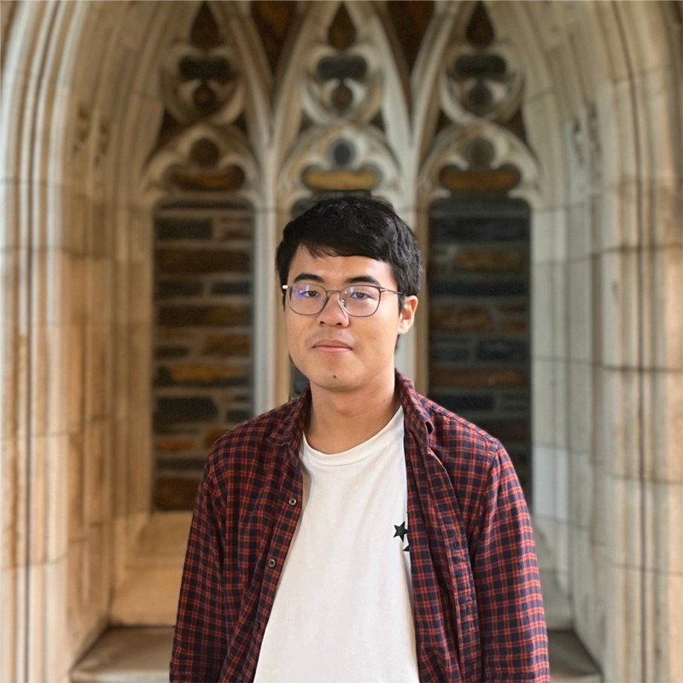
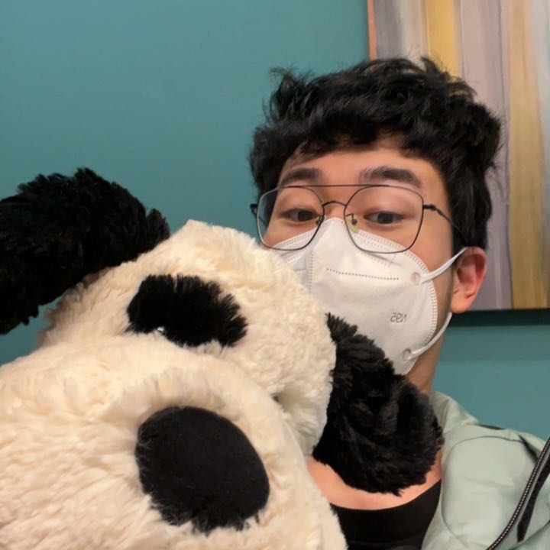
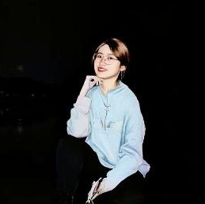
Our team
Chenglin Zhang
Lihui Chen
Yijia Xue
Algorithms; ETL engineering; Math Modeling & Optimization
Time Series Prediction; Disease Risk Factor Identification and Disease Screening
Visual Anomaly Detection;
XAI

Slide 4
02
Problem Introduction

Slide 5
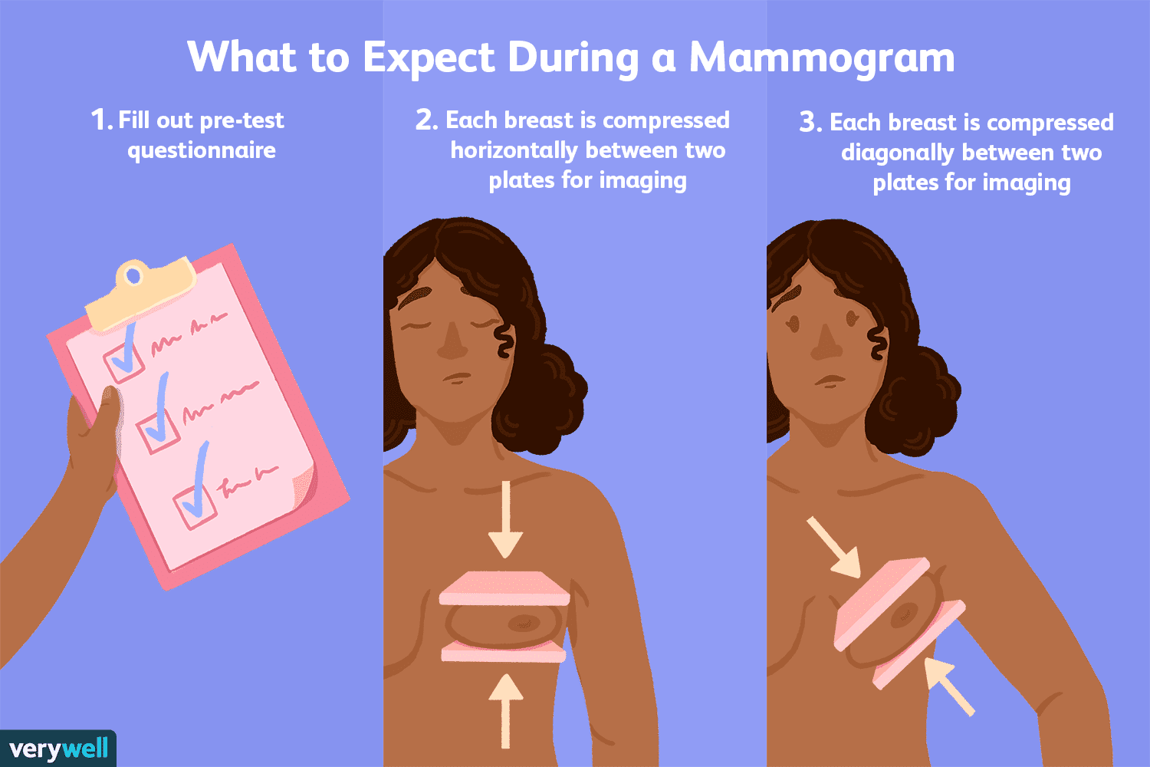
Problem Description: Mammography
Implement regular mammography screening in age groups considered at risk.
Early detection and treatment are critical to reducing cancer fatalities.

Slide 6
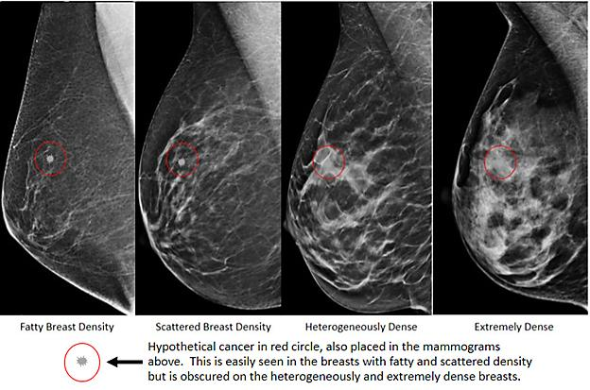
About Mammography
Composition of breasts
Fibrous and glandular tissue
higher density
white part on the screening image
Fat
lower density
black part on the screening image
Cancer cells
Unusual white dots on the screening image (circled in red)
This is because of the unusual growth of cells
https://www.snmmi.org/Patients/Procedures/Content.aspx?ItemNumber=13977

Slide 7
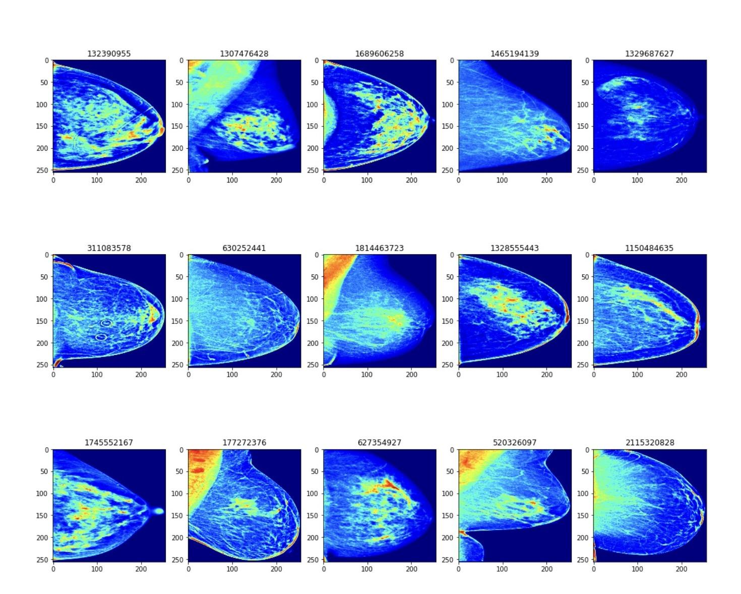
The objective
Identify breast cancer
Train a model with screening mammograms obtained from regular screening
Available training data:
The screening images (10000+ patients).
Patients’ age.
Density of the breast
Imaging machine type (Brand)
Whether cancer
whether case difficult to identify
Preprocessed images

Slide 8
Why is it significant for deep learning?
The expertise of highly-trained human observers (human resources are expensive).
A looming shortage of radiologists in several countries will likely worsen this problem.
High incidence of false positive results (humans make mistakes).
This can result in unnecessary anxiety, inconvenient follow-up care, extra imaging tests, and sometimes a need for tissue sampling (often a needle biopsy).
Enable radiologists to be more accurate and efficient.
Streamline the process radiologists use to evaluate screening mammograms.
Improving the quality and safety of patient care.
Help reduce costs and unnecessary medical procedures.

Slide 9
03
Previous Work and Limitations

Slide 10
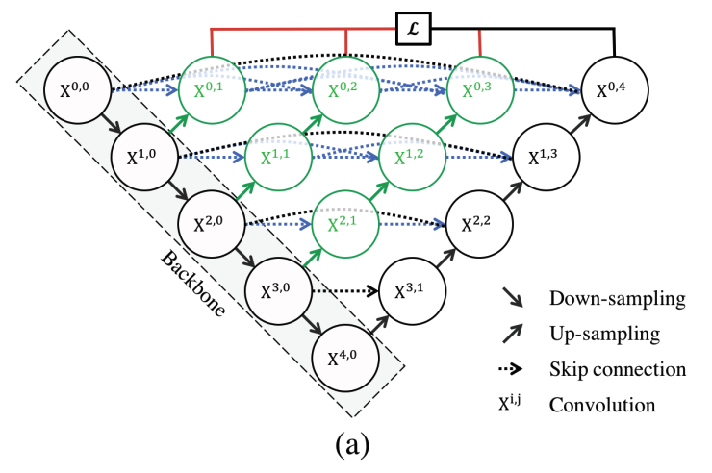
Research Contents-- Review
Zhou, Z., Rahman Siddiquee, M. M., Tajbakhsh, N., & Liang, J. (2018). Unet++: A nested u-net architecture for medical image segmentation. In Deep learning in medical image analysis and multimodal learning for clinical decision support (pp. 3-11). Springer, Cham.
UNet++ consists of an encoder and decoder that are connected through a series of nested dense convolutional blocks.
Image Credit: https://link.springer.com/chapter/10.1007/978-3-030-00889-5_1

Slide 11
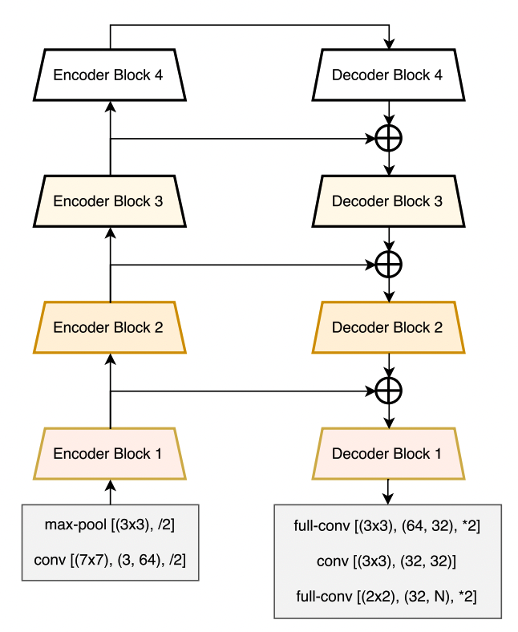
Research Contents-- Review
Chaurasia, A., & Culurciello, E. (2017, December). Linknet: Exploiting encoder representations for efficient semantic segmentation. In 2017 IEEE Visual Communications and Image Processing (VCIP) (pp. 1-4). IEEE.
Link each encoder with decoder
Input of each encoder layer is bypassed to the output of its corresponding decoder
Image Credit: https://ieeexplore-ieee-org.proxy.lib.duke.edu/abstract/document/8305148

Slide 12
Limitations on the CNN-Based Models
Use convolution to extract features in higher dimension. The perception field is approximately local within the convolution range.
Computationally inefficient due to large number of parameters and GFLOPS in convolutional layer.

Slide 13
04
Project
Research
Contents

Slide 14
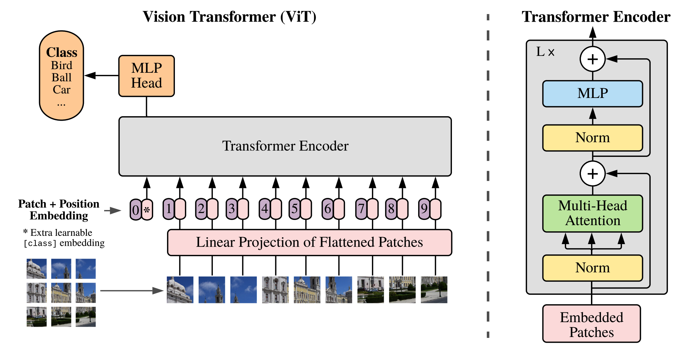
Research Contents-- Frontier Study
Application of Vision Transformer
Image Credit: https://arxiv.org/pdf/2010.11929v2.pdf

Slide 15
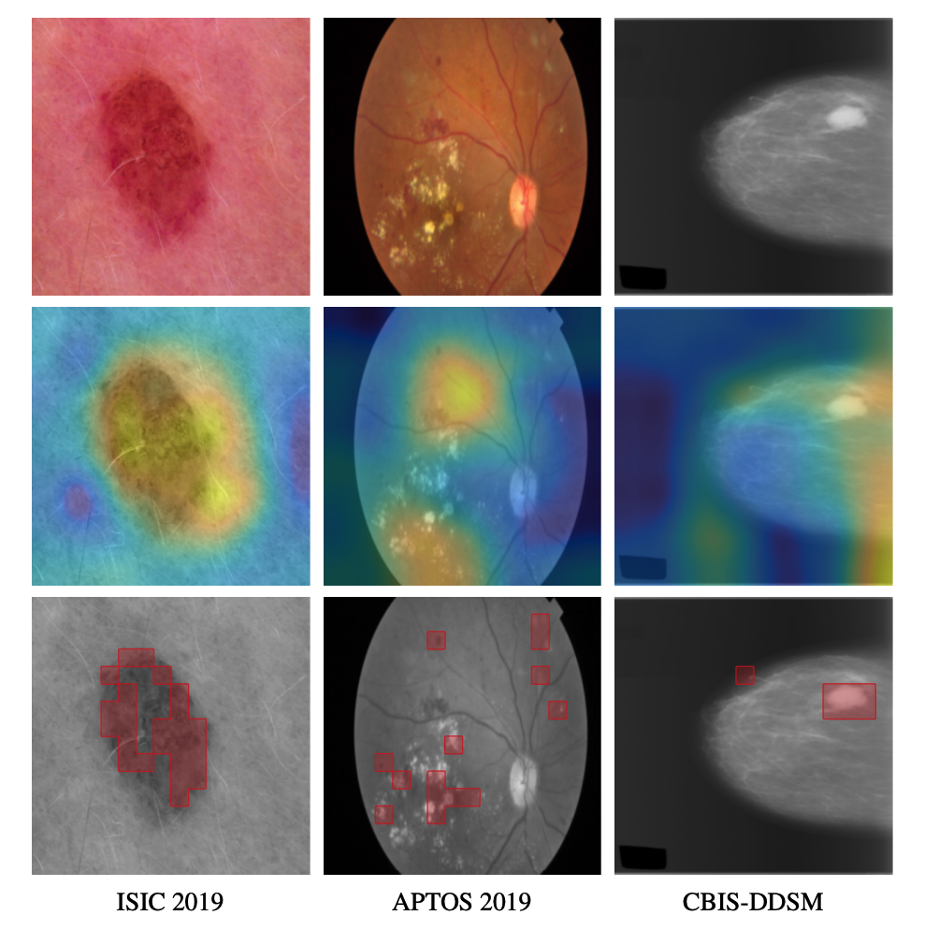
Research Contents-- Frontier Study
Application of Vision Transformer
In the work of Matsoukas et al.(2021), they point out in large scale dataset, Vit indeed has some advantages. Besides, the self-attention of ViTs provide a
clear, localized picture of the attention.
Image Credit:https://arxiv.org/pdf/2108.09038.pdf
Each column contains the original, a visualisation of the ResNet50’s Grad-CAM saliency and a visualisation of the DEIT-S’s attention map.

Slide 16
Contribution and Novelty
Investigate and apply the Vision Transformer to medical image classification task
Compare whether the transformer-based method outperform the CNN-based method on large labeled medical dataset
Validate the proposed method on a newly released large-scale medical dataset

Slide 17
Learning Objectives
Grabbing the ideas of some classical medical image analysis model
Exposure to Computer Vision related practical challenge
Learn how to implement the CNN-based, Transformer-based method in Pytorch framework
Learn how to deal with large-scale image dataset
How to make efficient group collaboration

Slide 18
References
Zhou, Z., Rahman Siddiquee, M. M., Tajbakhsh, N., & Liang, J. (2018). Unet++: A nested u-net architecture for medical image segmentation. In Deep learning in medical image analysis and multimodal learning for clinical decision support (pp. 3-11). Springer, Cham.
Chaurasia, A., & Culurciello, E. (2017, December). Linknet: Exploiting encoder representations for efficient semantic segmentation. In 2017 IEEE Visual Communications and Image Processing (VCIP) (pp. 1-4). IEEE.
Dosovitskiy, A., Beyer, L., Kolesnikov, A., Weissenborn, D., Zhai, X., Unterthiner, T., ... & Houlsby, N. (2020). An image is worth 16x16 words: Transformers for image recognition at scale. arXiv preprint arXiv:2010.11929.
Matsoukas, C., Haslum, J. F., Söderberg, M., & Smith, K. (2021). Is it time to replace cnns with transformers for medical images?. arXiv preprint arXiv:2108.09038.
Shamshad, F., Khan, S., Zamir, S. W., Khan, M. H., Hayat, M., Khan, F. S., & Fu, H. (2022). Transformers in medical imaging: A survey. arXiv preprint arXiv:2201.09873.

Slide 19
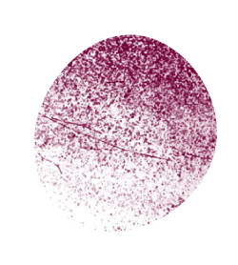
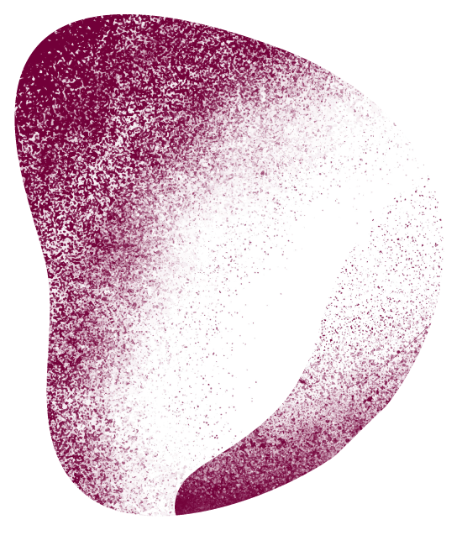
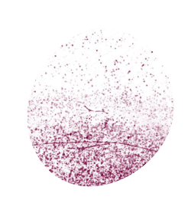
Thanks!
Do you have any questions?

